Slide 1
Ultra-Fast Electric Vehicle Charging Systems
Presenting Final Results
EE584: Power Electronics
Professor Sabzehgar
FALL 2025
LORANS HIRMEZ
REDID:821473582

Slide 2
System Architecture
Three Phase Grid
Active Rectifier
DC-DC converter
Battery

Slide 3
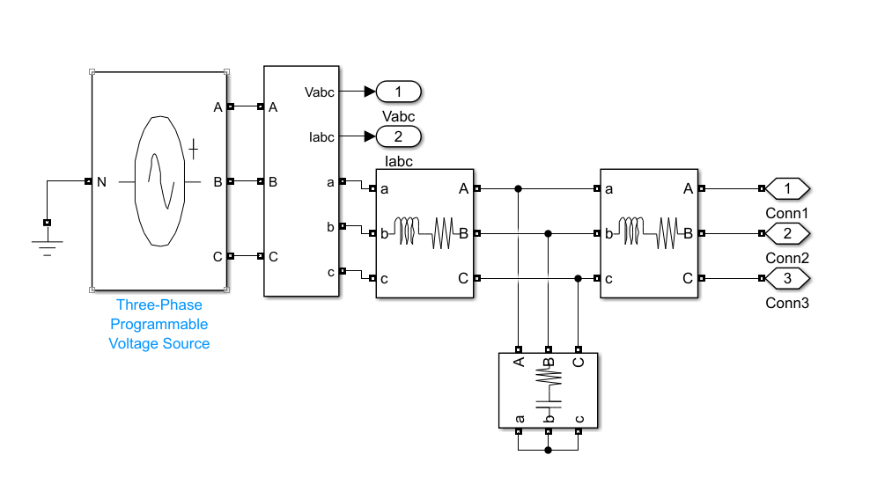
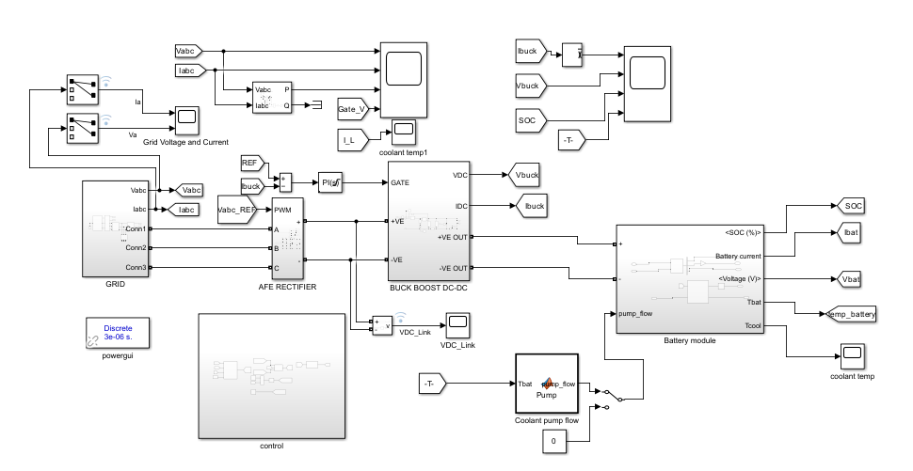
Three Phase Grid
Three Phase Voltage Source:
Vrms = 400V (line to line)
f = 50Hz
Notes:
Three Phase over single phase Grid
More efficient power transmission (requires less conductor material for the same power)
Smoother power delivery
Better suited for industrial loads and high-power applications

Slide 4
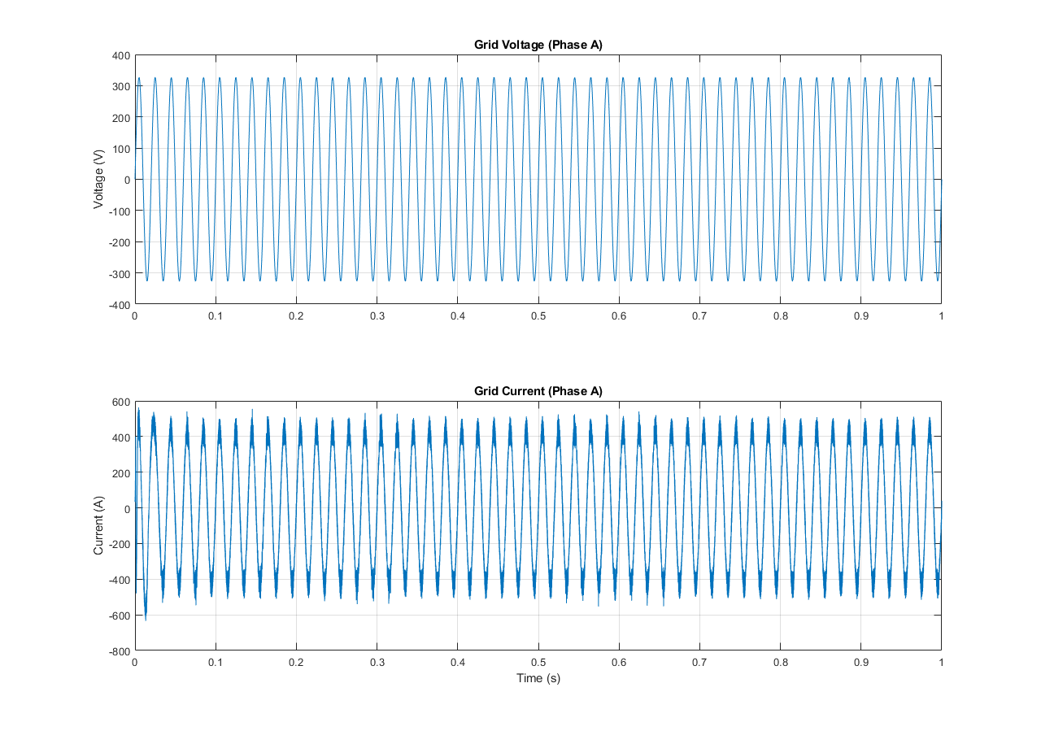
Three Phase Grid – Phase A Waveform
Phase A: Voltage oscillates approximately +/- 323V @ 50Hz
Phase A: Current oscillates approximately +/- 430A @ 50Hz
Notes:
Phase A is identical to B and C in shape and magnitude but there will be a phase shift difference.

Slide 5
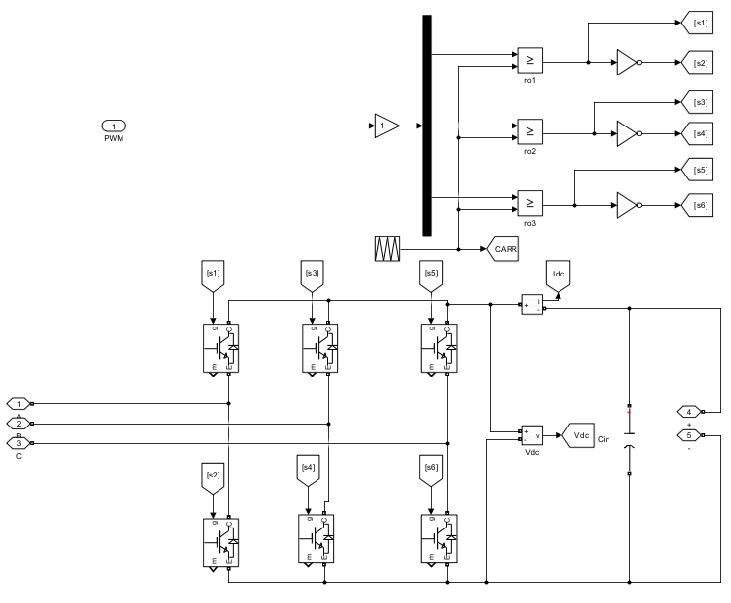
Three Phase Active Rectifier

Slide 6
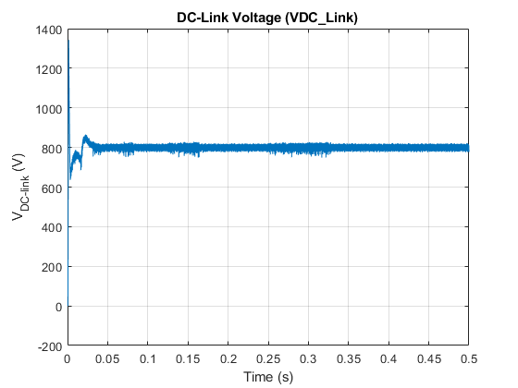
Three Phase Active Rectifier cont.
Three Phase Active Rectifier:
DC-link voltage = 800 V

Slide 7
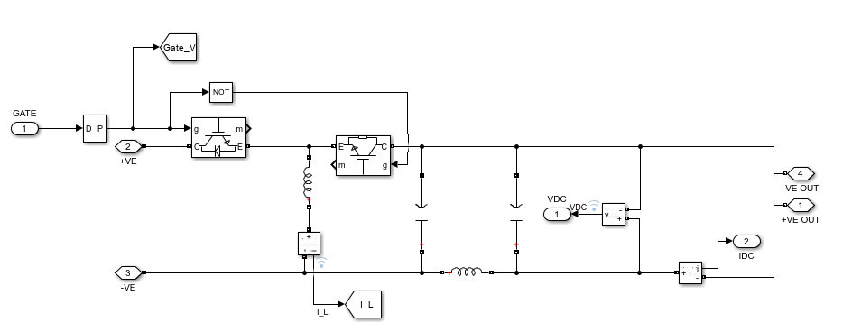
DC-DC Buck-Boost Converter

Slide 8
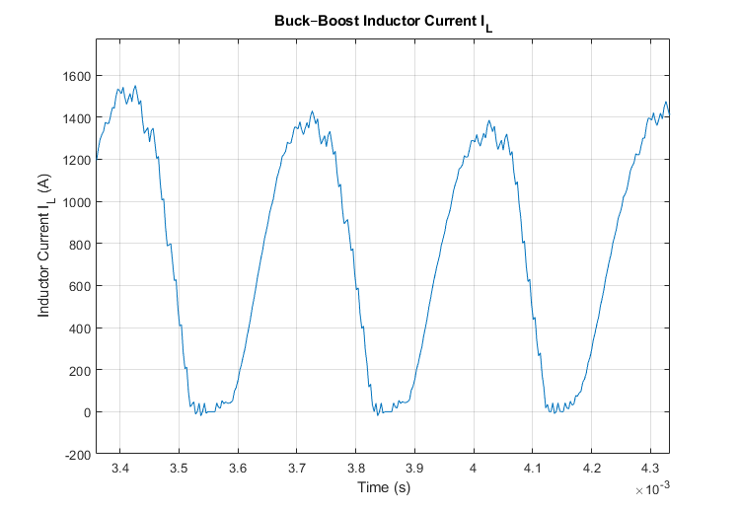
DC-DC Buck-Boost Converter cont.

Slide 9
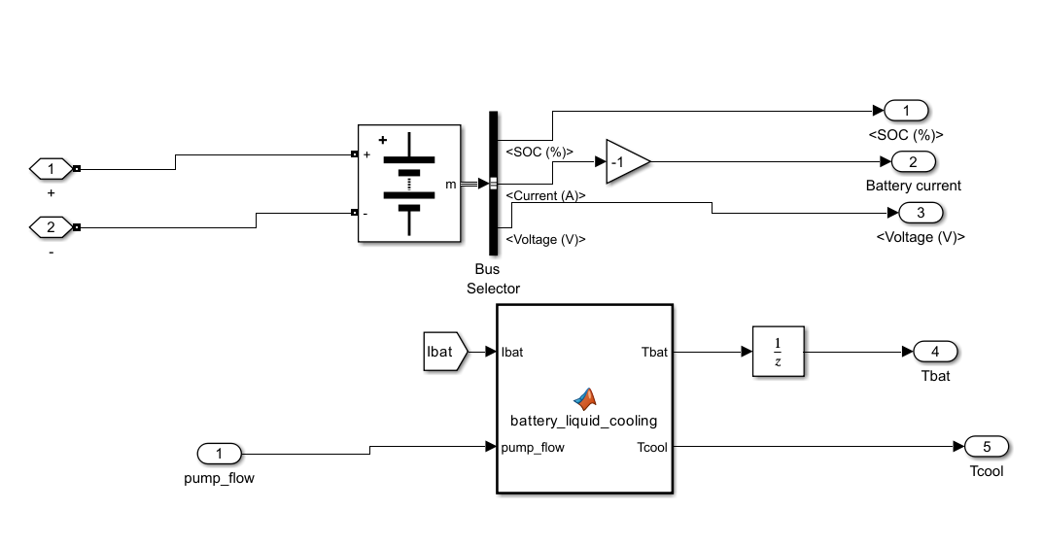
Battery

Slide 10
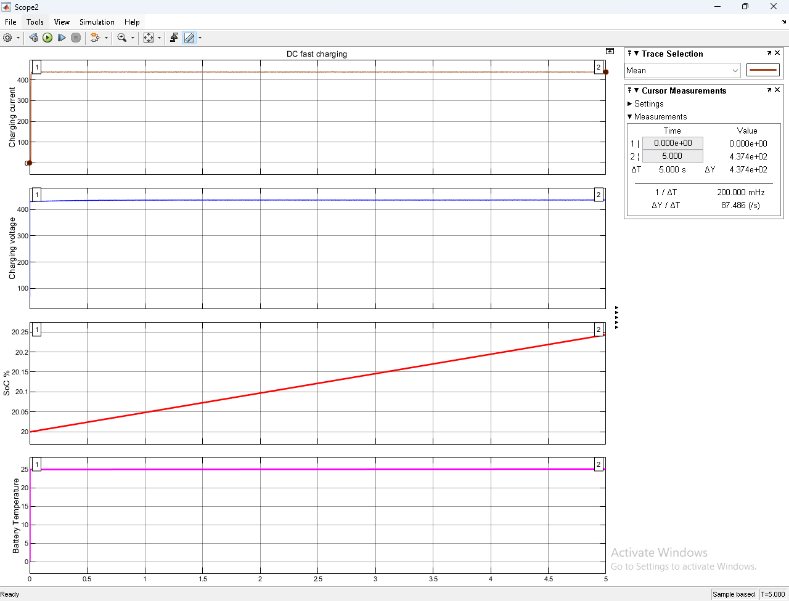
Battery Cont.
Charging Current = 437.5A.
Charging Voltage = 430V.
SOC from 20% to 20.25% in 5 seconds.
Battery Temperature = 25˚C.

Slide 11
Key Parameters
Parameter | Value | Notes
Battery energy | 100 kWh | Pack nominal energy
Pack nominal voltage | 350–450 V | Used for CC/CV logic
Constant current in CC | 437.5 A | Used for CC mode
Constant Voltage in CV | 450 V | Used for CV mode
Battery mass (m) | 500 kg | From project image
Battery specific heat (cp) | 1000 J/kg·°C
Battery thermal capacitance | 5e5 J/°C | m × cp = 500*1000
Surface area (A) | 3 m² | Cold-plate contact area (estimate)
Heat transfer coefficient (h) | ≈50 W/m²·°C (liquid cold plate) | h × A ≈ 150 W/°C
Coolant inlet temp | 20 °C | Glycol-water mixture setpoint
Ambient temp | 25 °C | Environmental temperature
Coolant lumped thermal capacitance | 5e2–5e3 J/°C | Depends on coolant volume; default 500 J/°C
Internal resistance | 0.002–0.01 Ω

Slide 12
Conclusion
Chose Liquid Cooling method for thermal management because it was cost effective and safe for operating conditions
Challenges faced during simulation process was Simulink’s syntax errors

